Slide 1
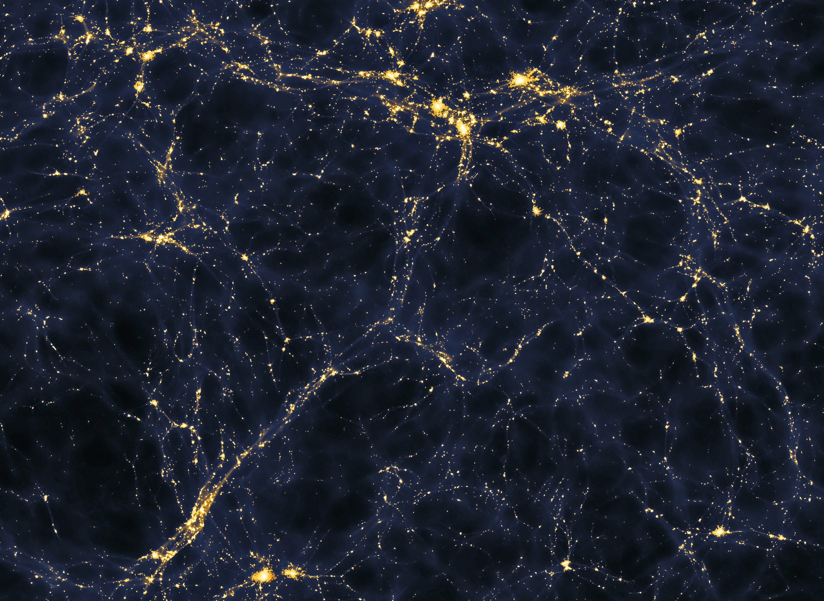


An overview of :
A theoretical view on the T-web
statistical description of the cosmic web
A
stronomy
Emma Aycoberry, Alexandre Barthelemy, Sandrine Codis
&
A
strophysics
October 6, 2023
Resources:
github.com/parsa-ghafour/Conferences_and_Seminars
Faculty of Physics, Kharazmi University, Tehran, Iran
arXiv:2310.03548v1
Parsa Ghafour
, 3rd December 2023

Slide 2

Introduction:
01
6%
Cosmic web
Void
Filament(s)
Wall
Node
Vast regions with very low cosmic mean densities
Have roughly similar major and minor axes in cross-section
Have a significantly greater major axis than minor axis in cross-section
Highly concentrated zones where walls meet and intersect
Faculty of Physics, Kharazmi University, Tehran, Iran
arXiv:2310.03548v1
Parsa Ghafour
, 3rd December 2023

Slide 3
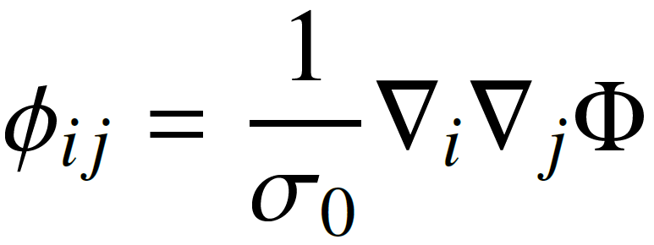
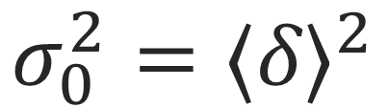
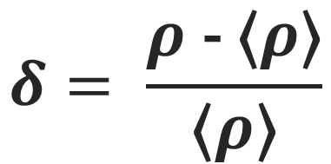

T-web classification
of the cosmic web:
02
$$Φ , ρ$$
12%
Gravitational potential
Density field
Variance of the contrast of the density field
Normalize the derivatives of the gravitational potential
$$δ= \frac{ρ\text{ − }\text{⟨}ρ\text{⟩}}{\text{⟨}ρ\text{⟩}}$$
$$σ_{0}^{2}={\text{⟨}δ\text{⟩}}^{2}$$
Pogosyan et al. 2009
Faculty of Physics, Kharazmi University, Tehran, Iran
arXiv:2310.03548v1
Parsa Ghafour
, 3rd December 2023

Slide 4
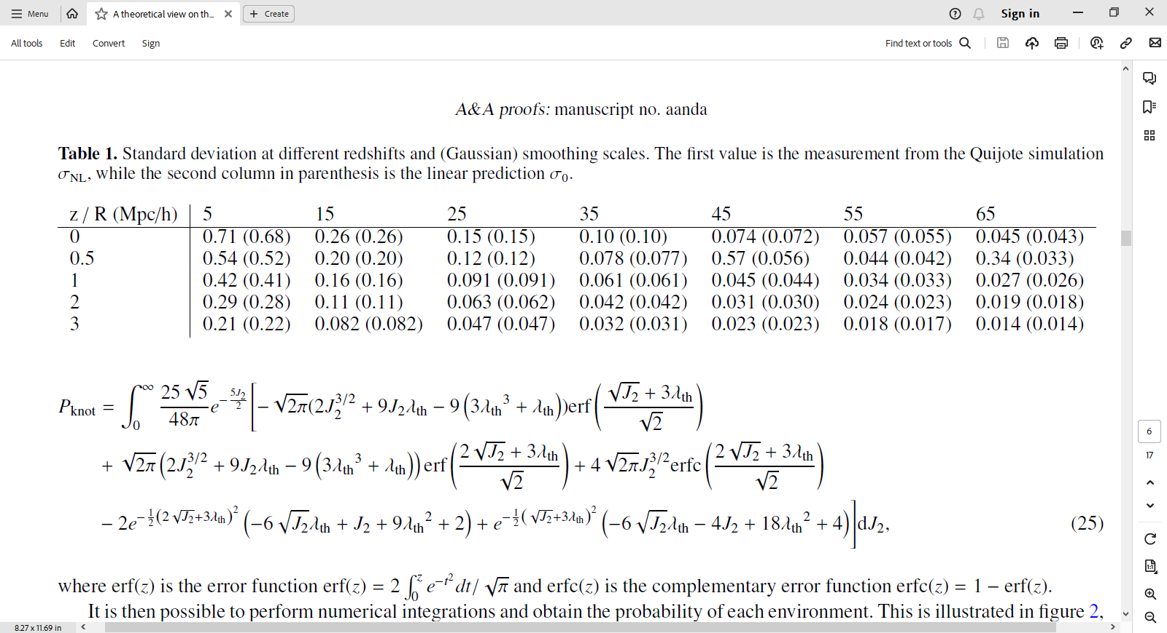
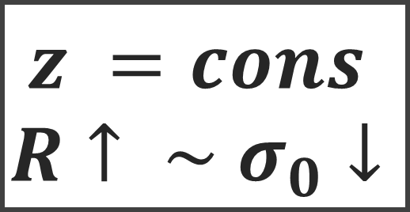
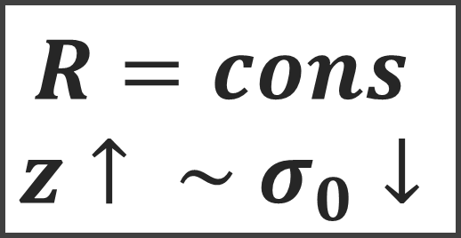
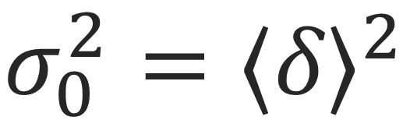
T-web classification
of the cosmic web:
03
$$σ_{0}^{2}={\text{⟨}δ\text{⟩}}^{2}$$
17%
Standard deviation at different redshifts and (Gaussian) smoothing scales.
$$R=cons$$
$$z↑ \sim σ_{0}↓$$
$$z =cons$$
$$R↑ \sim σ_{0}↓$$
(Cui et al. 2017, 2019)
Faculty of Physics, Kharazmi University, Tehran, Iran
arXiv:2310.03548v1
Parsa Ghafour
, 3rd December 2023

Slide 5
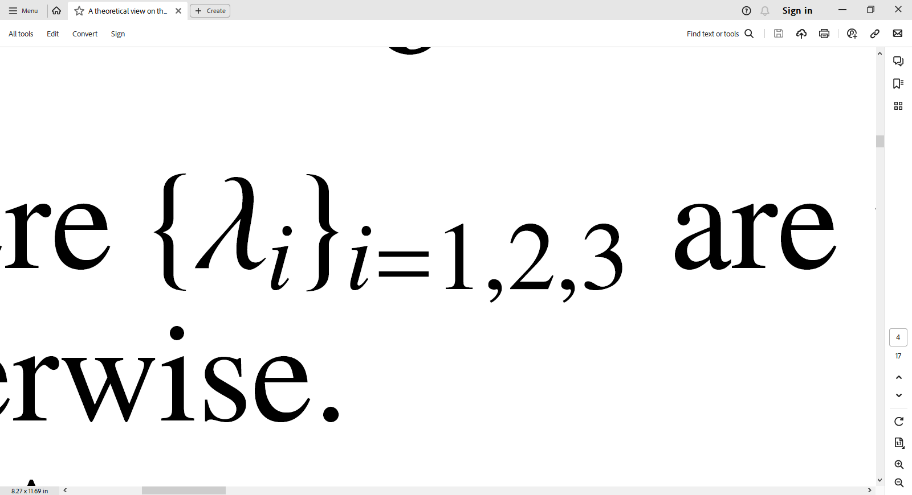
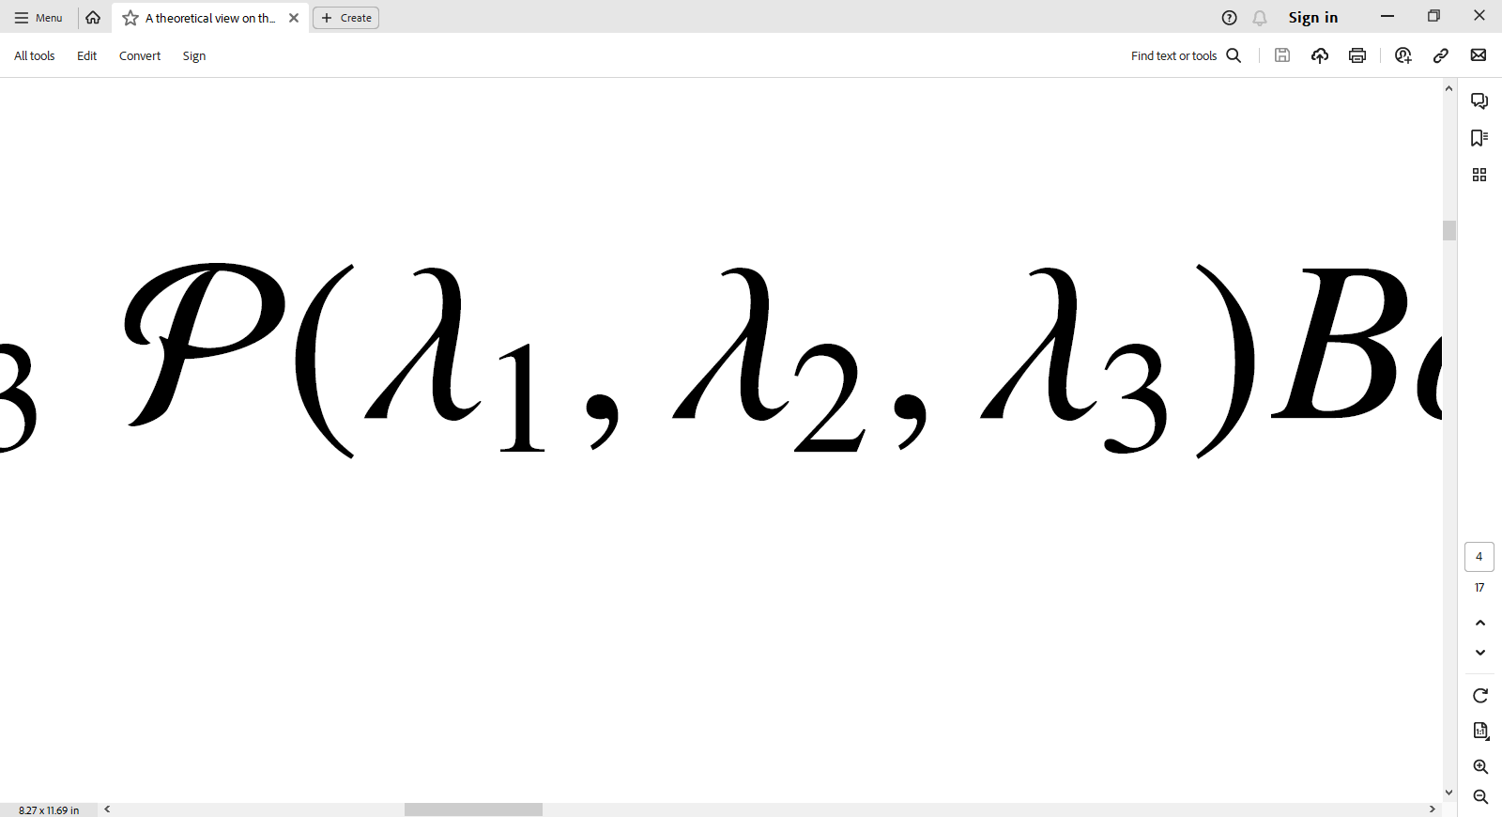
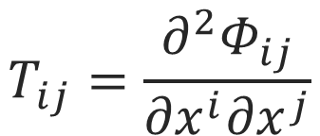
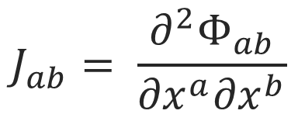
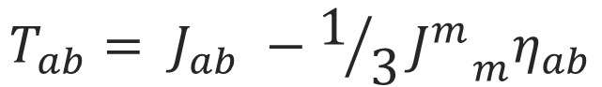
T-web classification
of the cosmic web:
04
$$T_{ab}= J_{ab} −1/3{J^{m}}_{m}η_{ab}$$
23%
$$J_{ab}= \frac{∂^{2}Φ_{ab}}{{∂x}^{a}{∂x}^{b}}$$
Tidal tensor
Tidal shear tensor
Diagonalize
Joint probability distribution
$$T_{ij}=\frac{∂^{2}Φ_{ij}}{{∂x}^{i}{∂x}^{j}}$$
Forero-Romero et al. (2009)
Hahn et al. (2007a)
Faculty of Physics, Kharazmi University, Tehran, Iran
arXiv:2310.03548v1
Parsa Ghafour
, 3rd December 2023

Slide 6
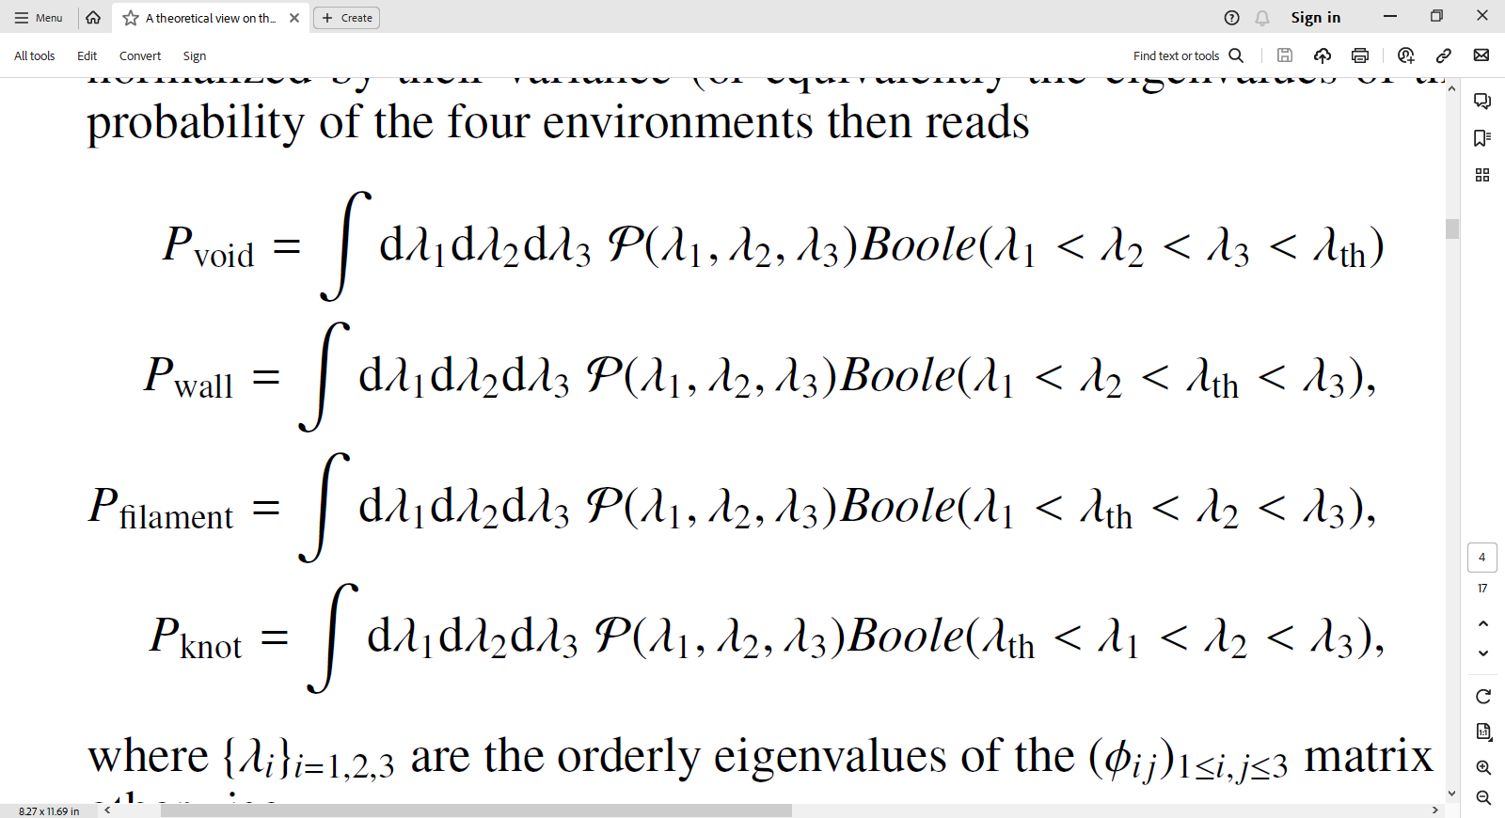
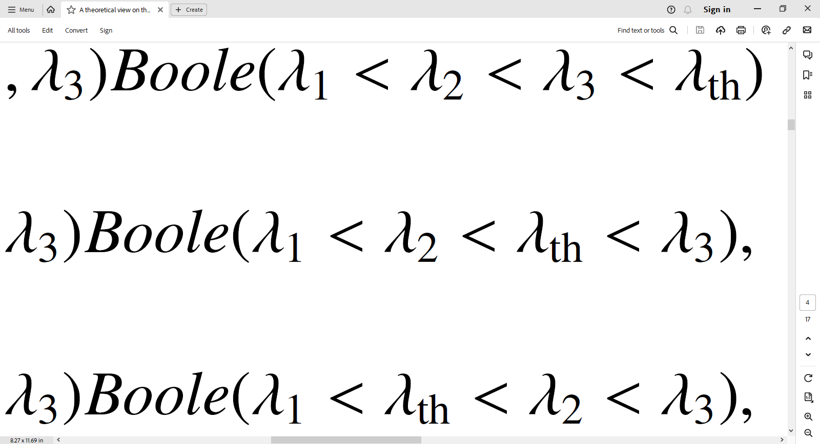

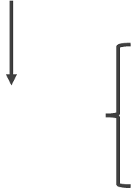
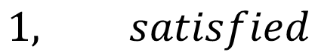
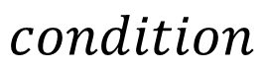
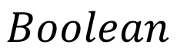
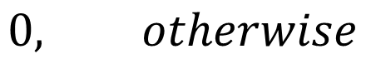
T-web classification
of the cosmic web:
05
29%
Probability of void
Probability of wall
Probability of filament
Probability of knot
$$Boolean$$
$$1, satisfied$$
$$condition$$
$$0, otherwise$$
Faculty of Physics, Kharazmi University, Tehran, Iran
arXiv:2310.03548v1
Parsa Ghafour
, 3rd December 2023

Slide 7
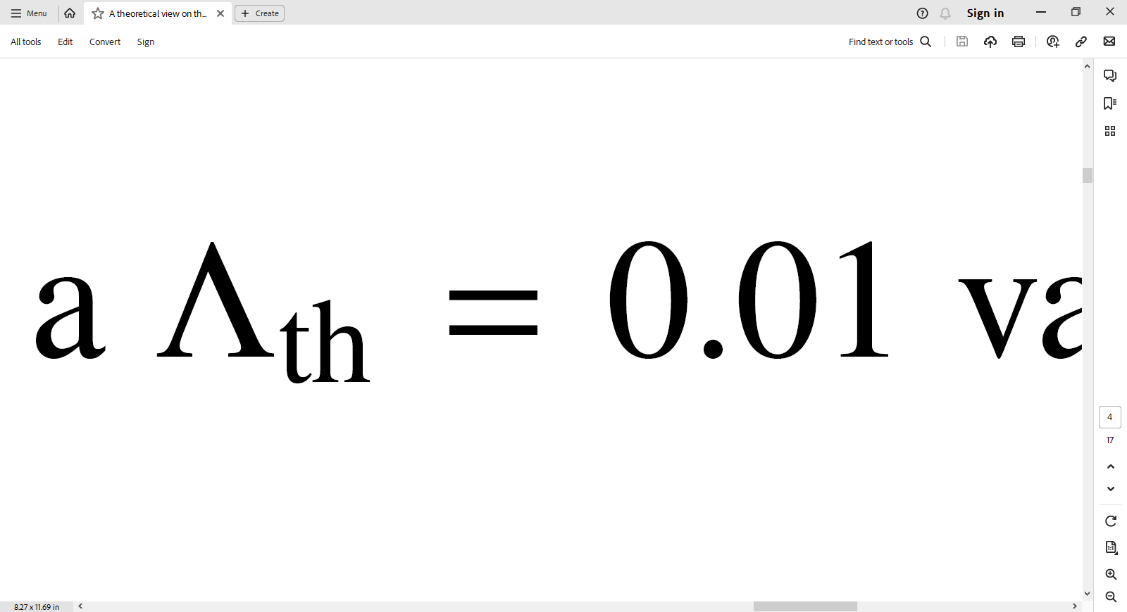
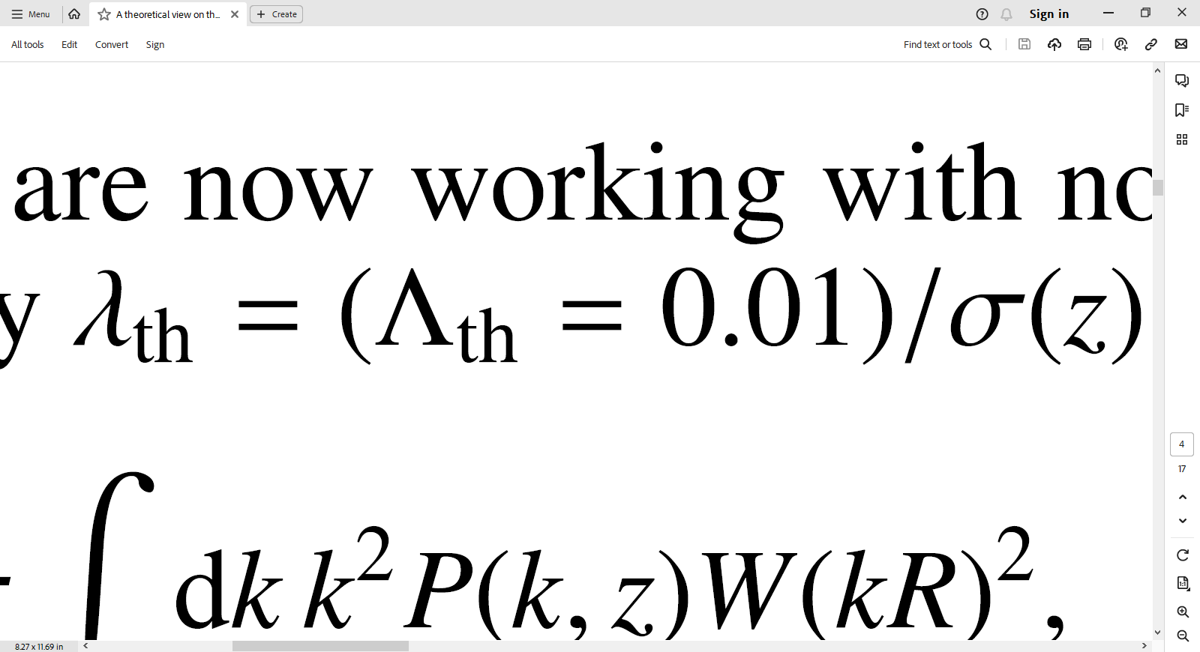
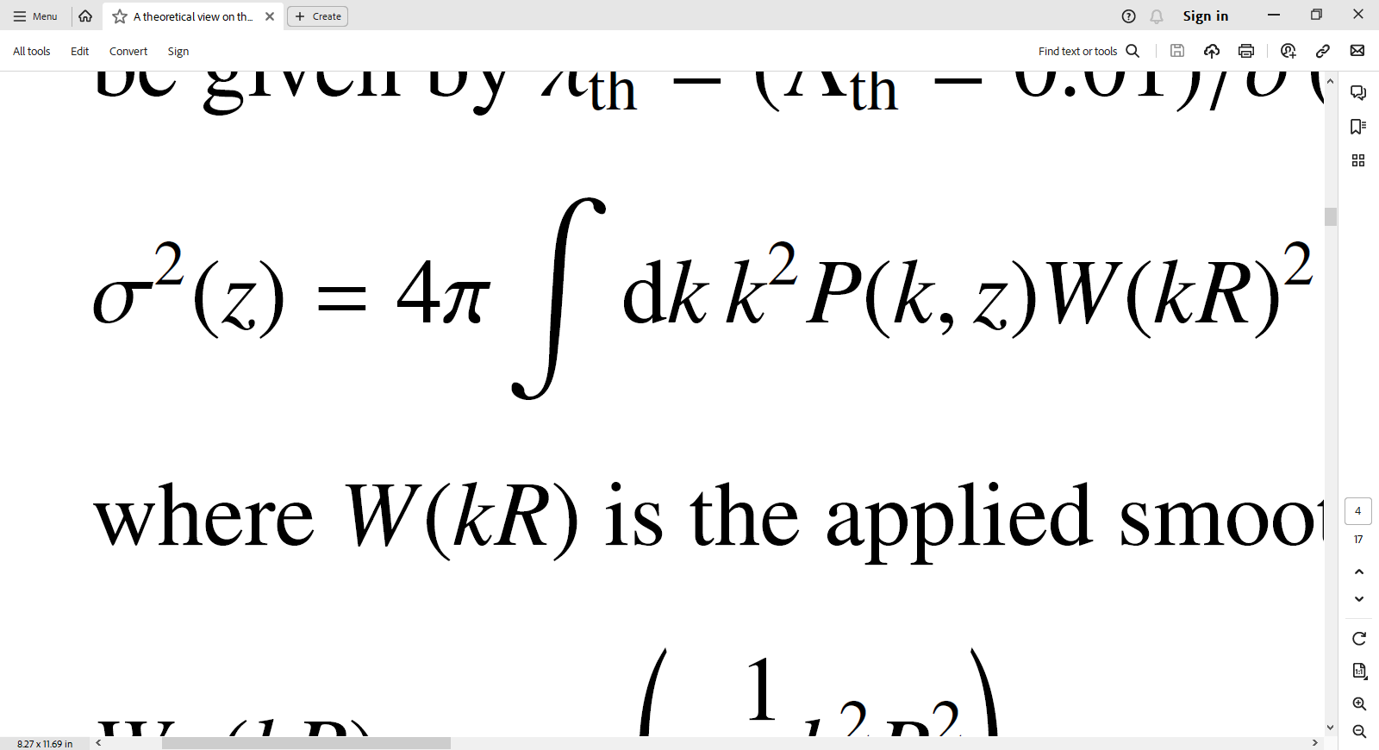
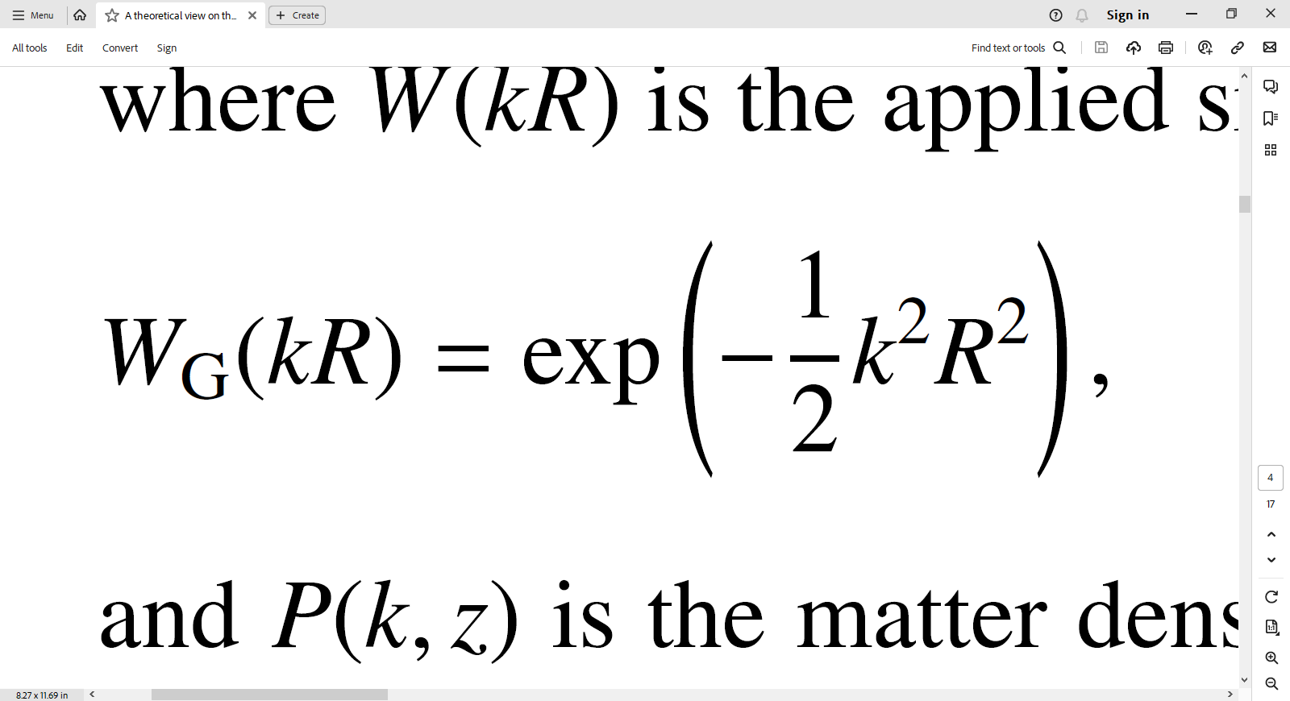
T-web classification
of the cosmic web:
06
Free parameter
35%
Chosen threshold
Applied smoothing
Matter density power spectrum
Faculty of Physics, Kharazmi University, Tehran, Iran
arXiv:2310.03548v1
Parsa Ghafour
, 3rd December 2023
Notes:
Difference between the local density and the mean density

Slide 8
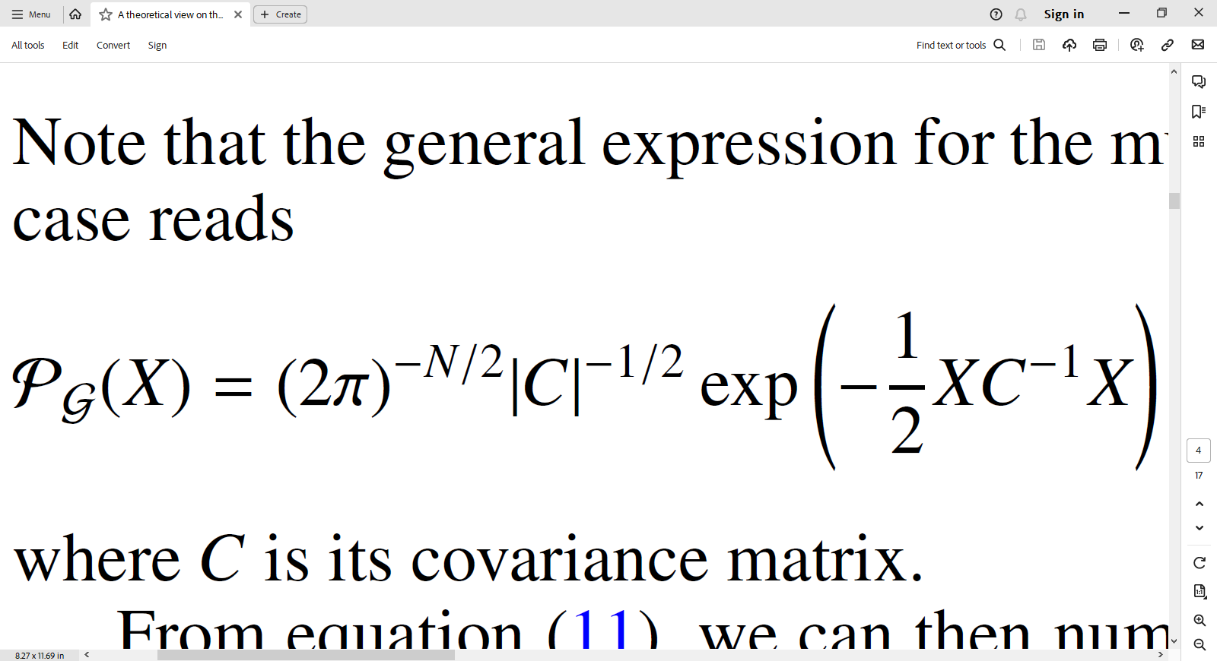
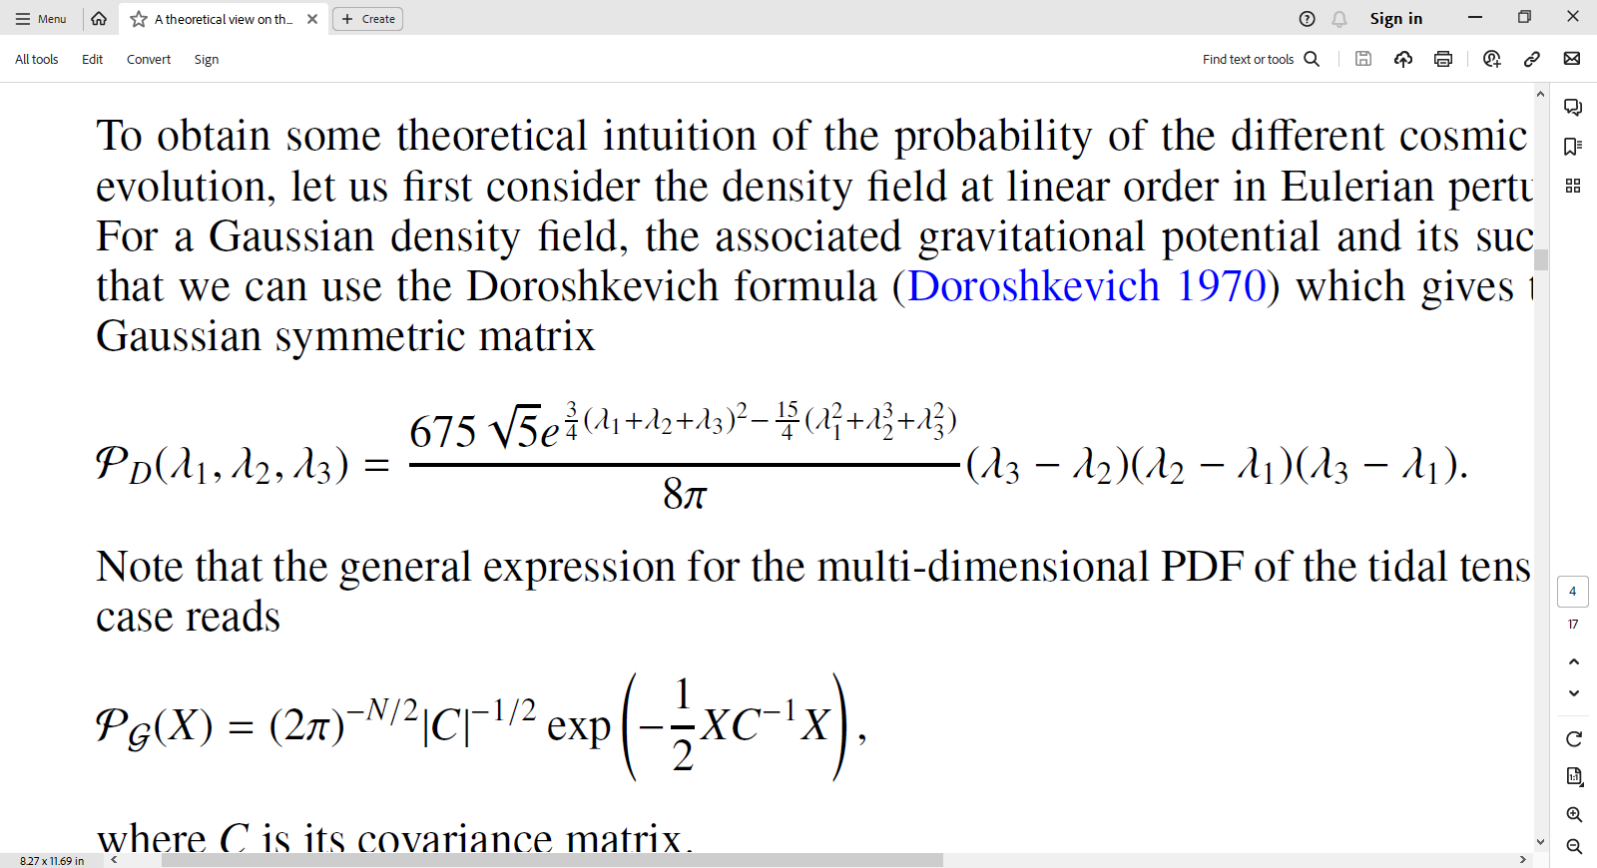
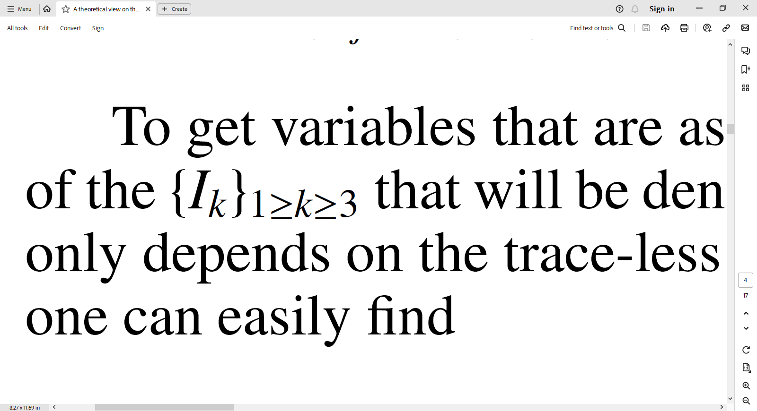
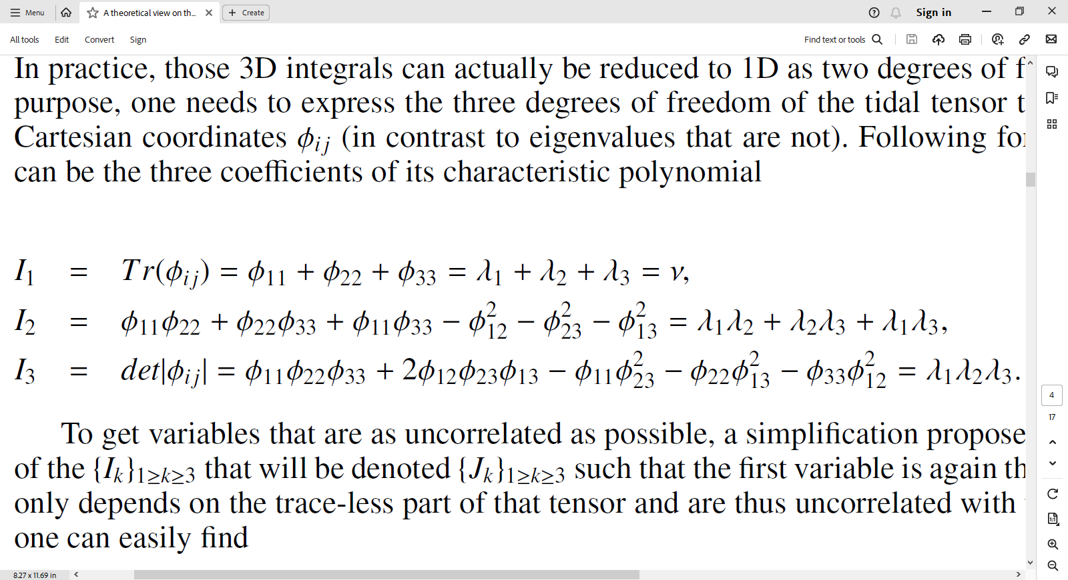
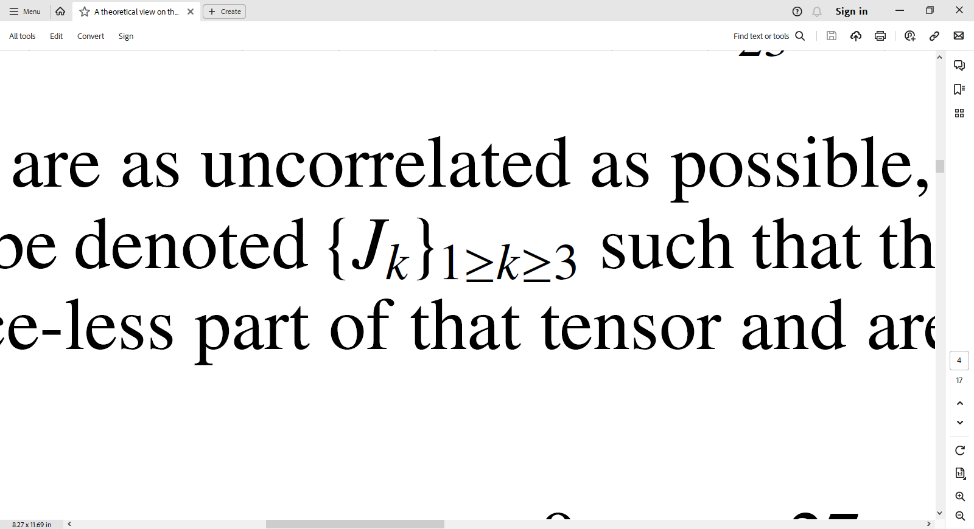
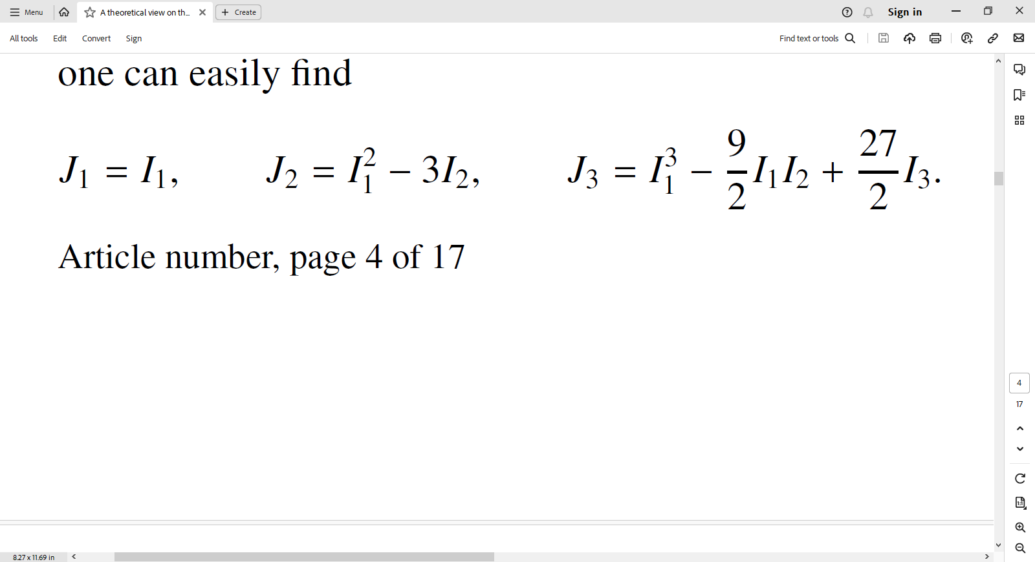
Evolution regimes:
07
41%
Linear regime:
Gaussian expansion
Doroshkevich formula
Uncorrelated variables
Rotation invariant
(Doroshkevich 1970)
:
Pogosyan et al. 2009
:
Faculty of Physics, Kharazmi University, Tehran, Iran
arXiv:2310.03548v1
Parsa Ghafour
, 3rd December 2023
Notes:
Regimes for evolution of z and R(smoothing scale)

Slide 9
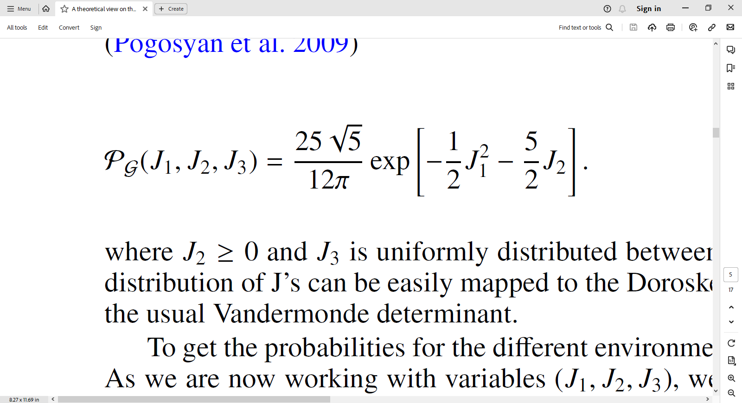
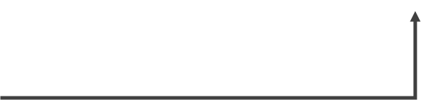
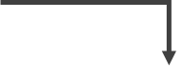
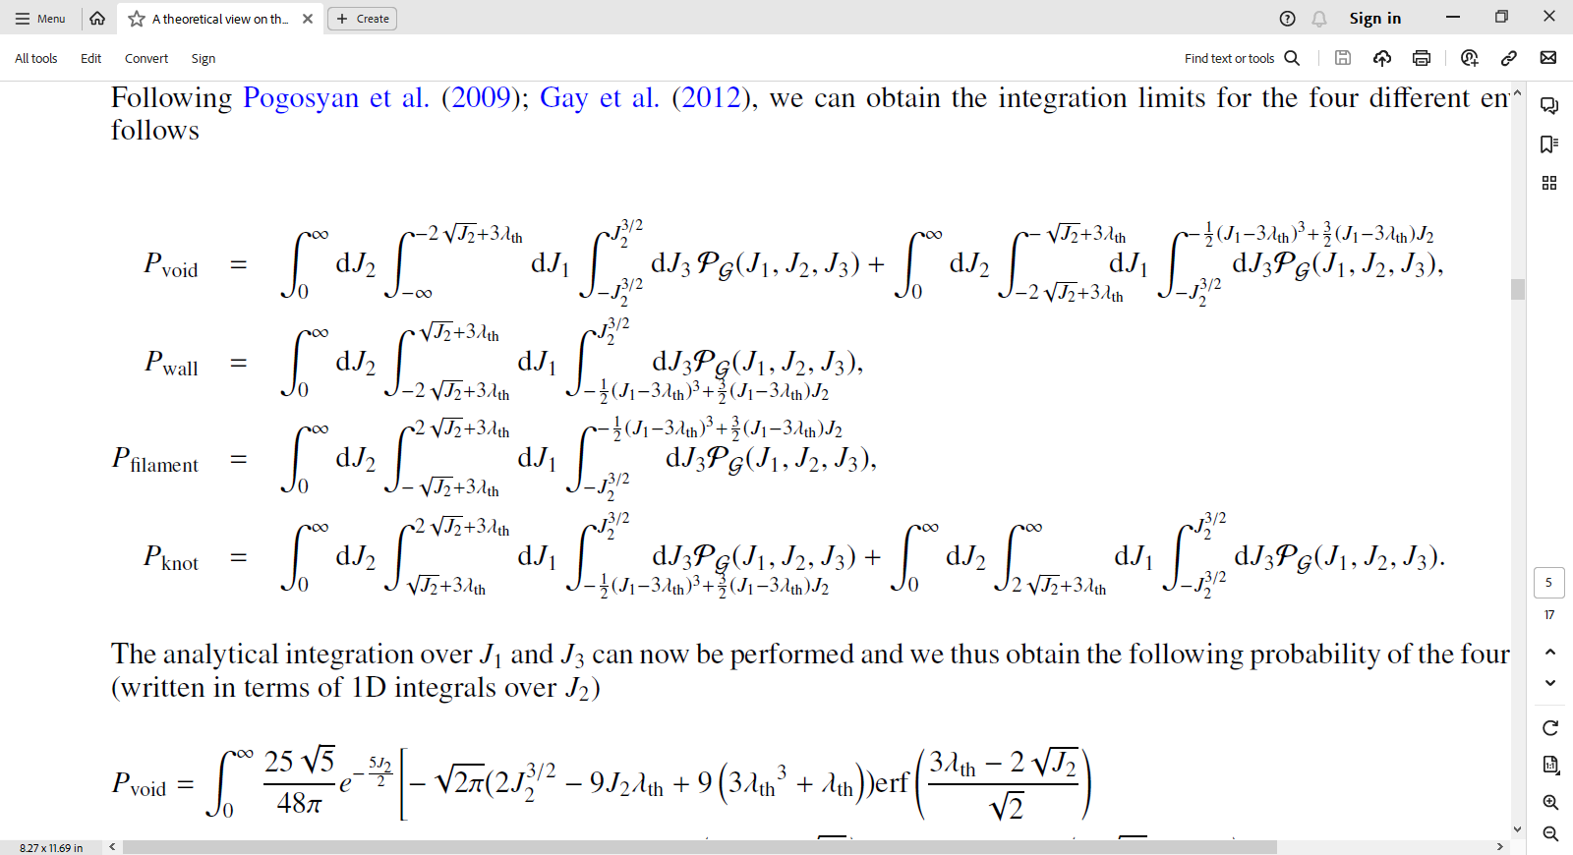
Evolution regimes:
08
47%
Linear regime:
Gaussian random filed
Probabilities for the
different environments
Pogosyan et al. 2009
Pogosyan et al. (2009); Gay et al. (2012)
Faculty of Physics, Kharazmi University, Tehran, Iran
arXiv:2310.03548v1
Parsa Ghafour
, 3rd December 2023

Slide 10
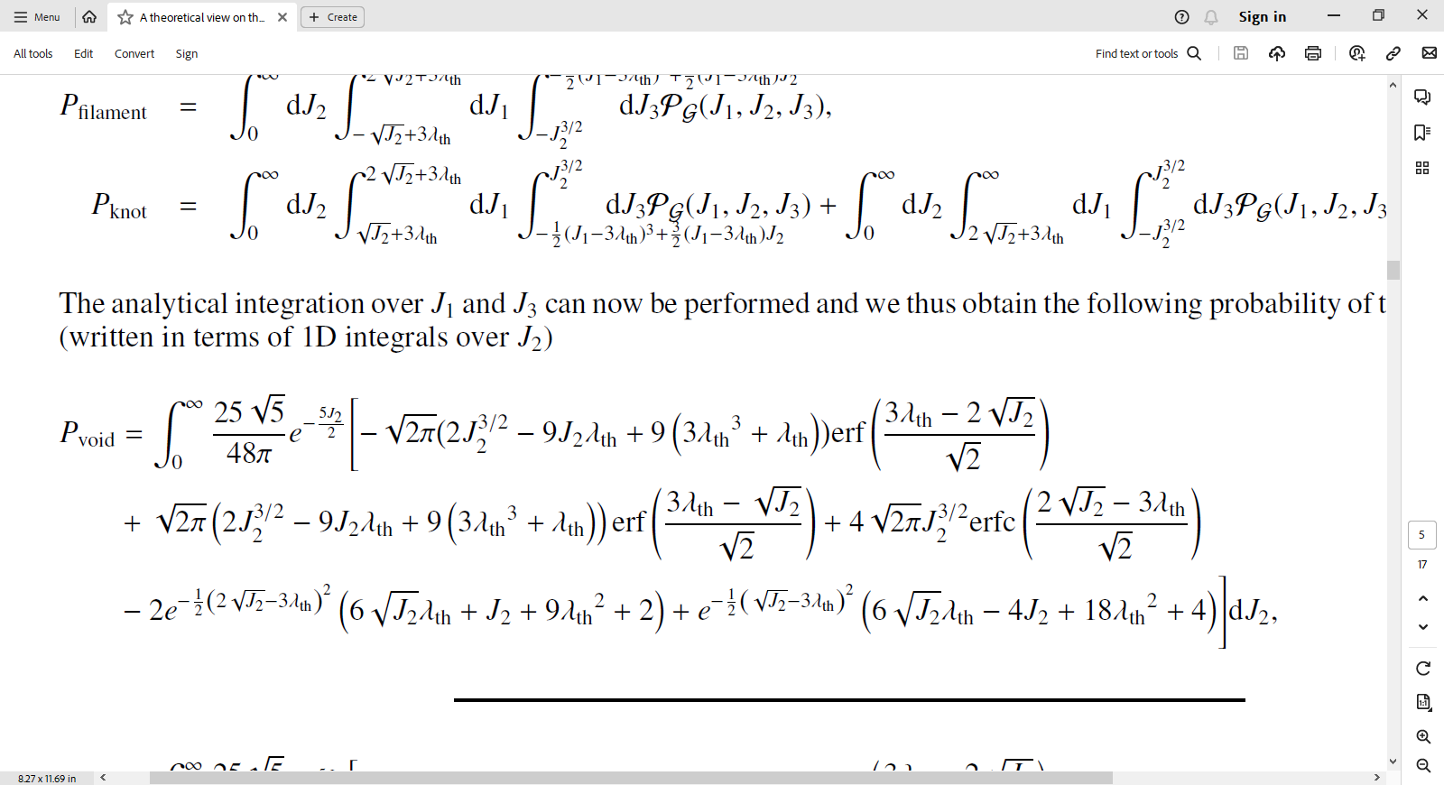
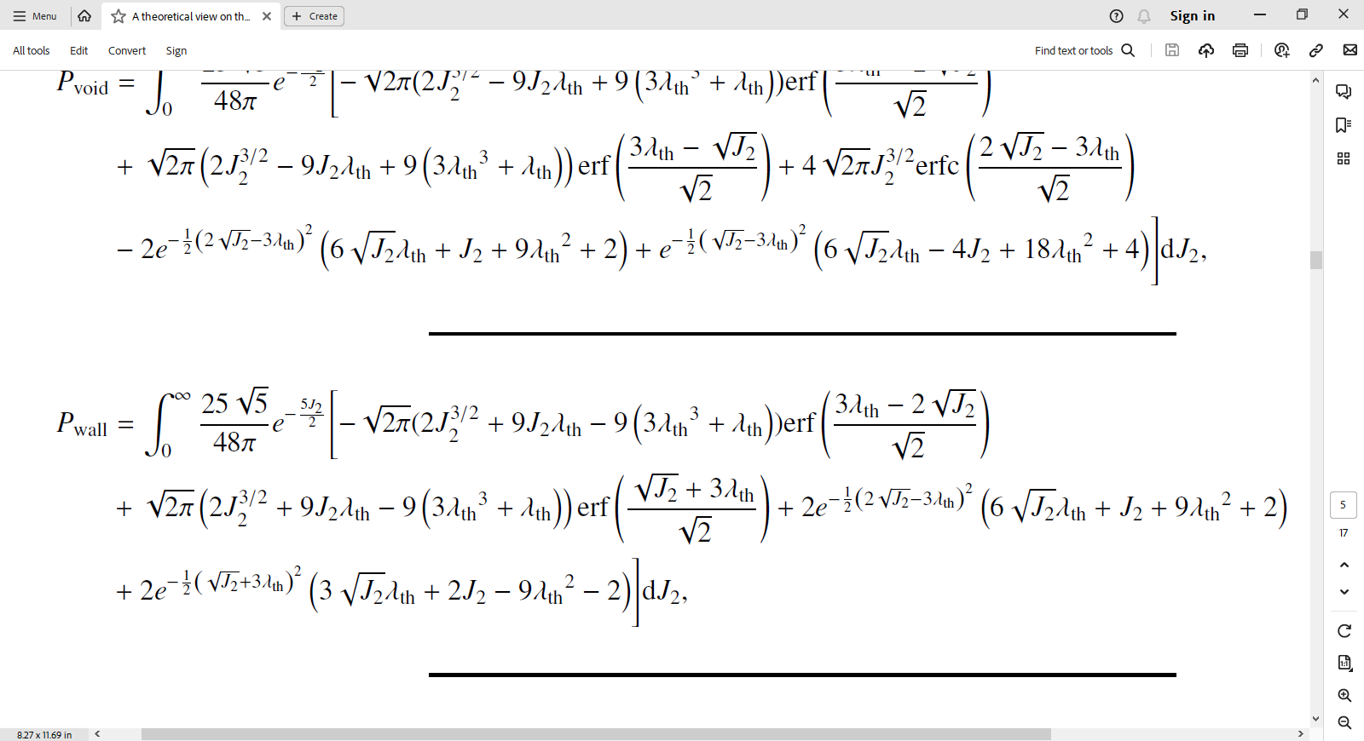
Evolution regimes:
09
Linear regime:
3D integrals can be reduced to 1D:
two degrees of freedom can
be analytically integrated out
53%
Faculty of Physics, Kharazmi University, Tehran, Iran
arXiv:2310.03548v1
Parsa Ghafour
, 3rd December 2023

Slide 11
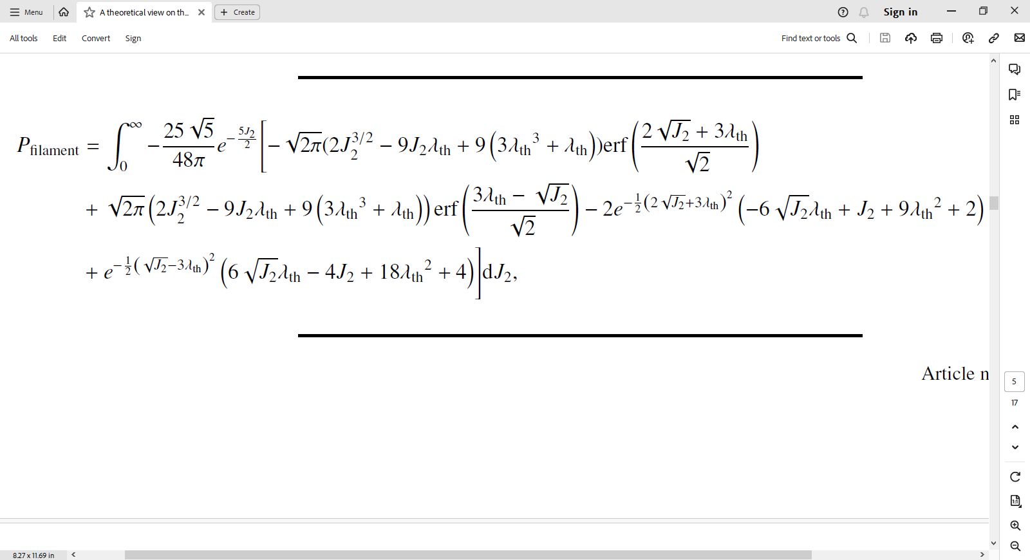
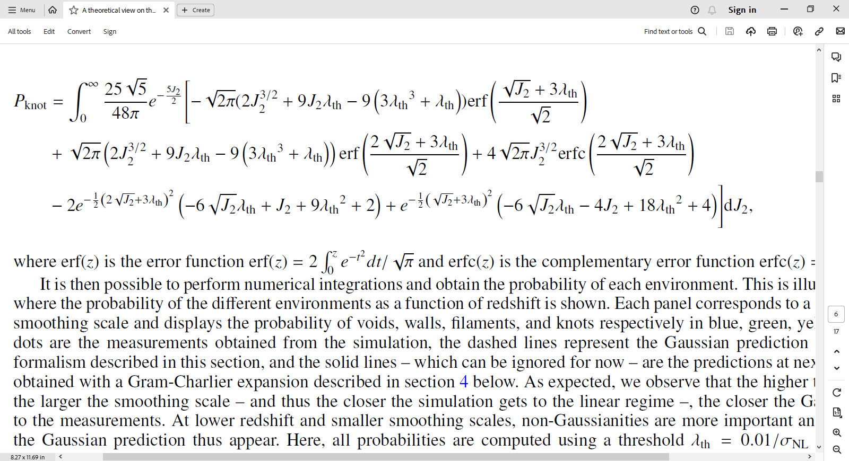
Evolution regimes:
10
Linear regime:
3D integrals can be reduced to 1D:
two degrees of freedom can
be analytically integrated out
59%
Faculty of Physics, Kharazmi University, Tehran, Iran
arXiv:2310.03548v1
Parsa Ghafour
, 3rd December 2023

Slide 12
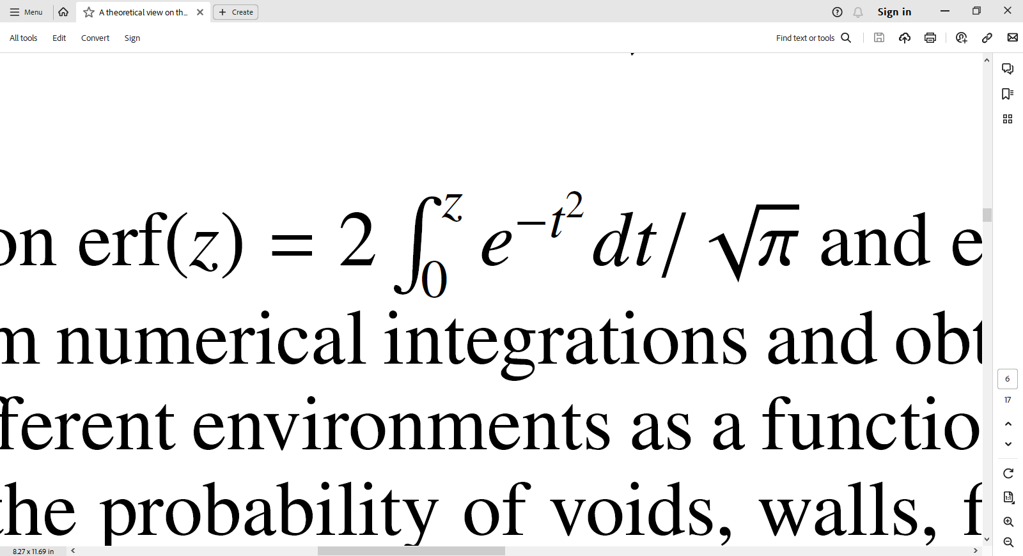
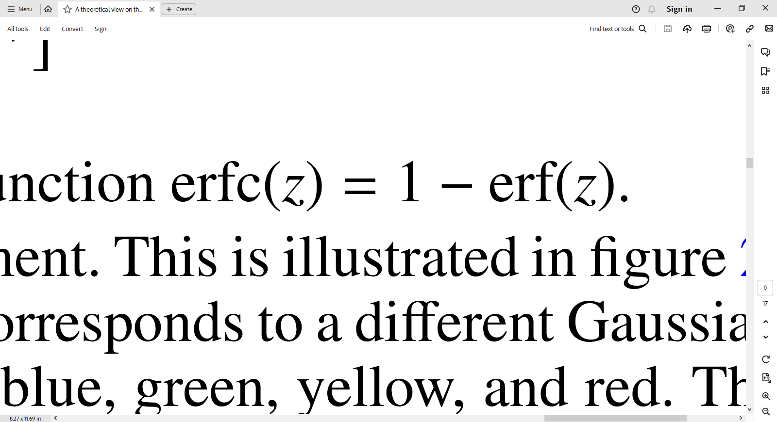
Evolution regimes:
11
65%
Linear regime:
In each probability:
Integration interval
Error function
Complementary error function
Faculty of Physics, Kharazmi University, Tehran, Iran
arXiv:2310.03548v1
Parsa Ghafour
, 3rd December 2023

Slide 13
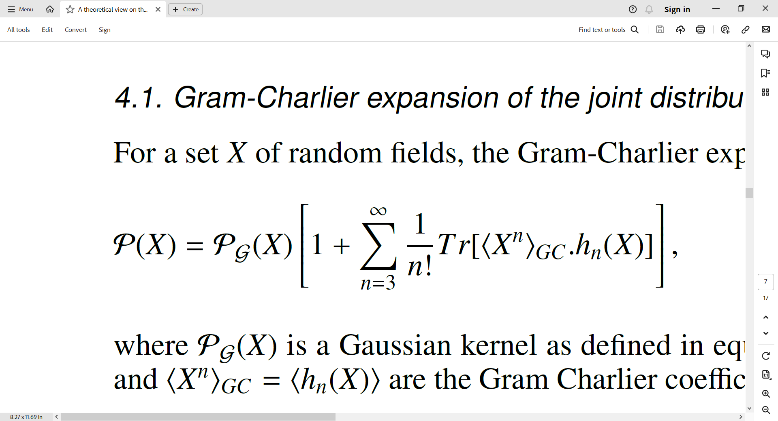

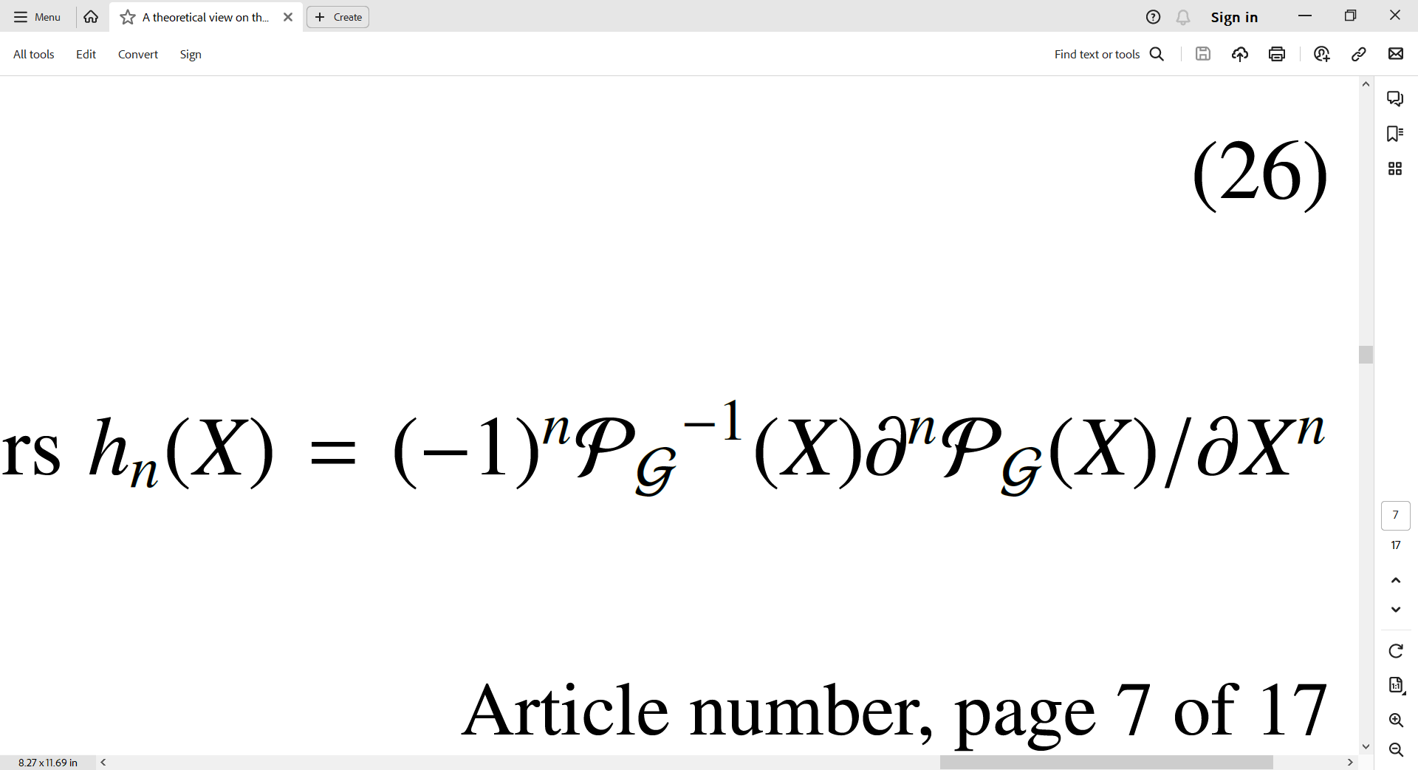

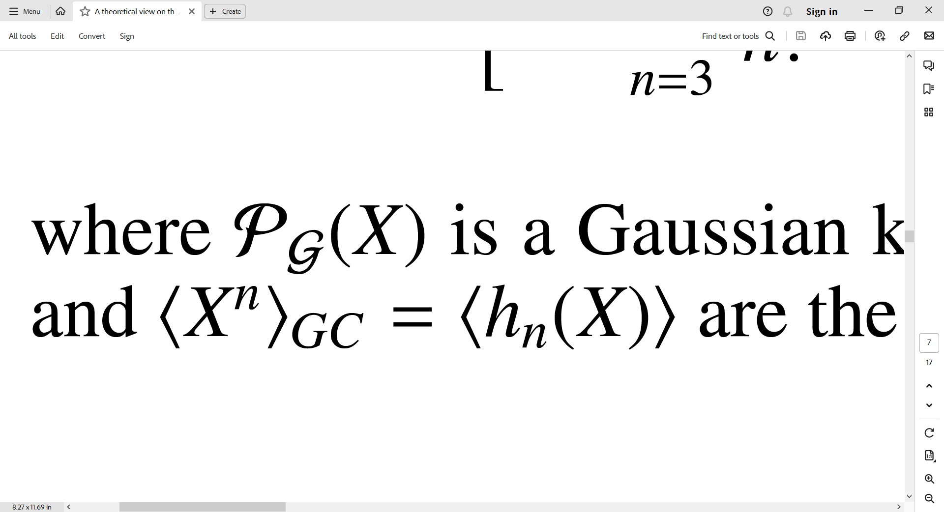
Evolution regimes:
12
71%
Non-Linear regime:
Low redshift/small scales
Non-gaussian corrections
Gram-Charlier expansion
Gaussian kernel
Hermite tensors
Pogosyan et al. (2009); Gay et al. (2012); Codis et al. (2013).
Faculty of Physics, Kharazmi University, Tehran, Iran
arXiv:2310.03548v1
Parsa Ghafour
, 3rd December 2023

Slide 14
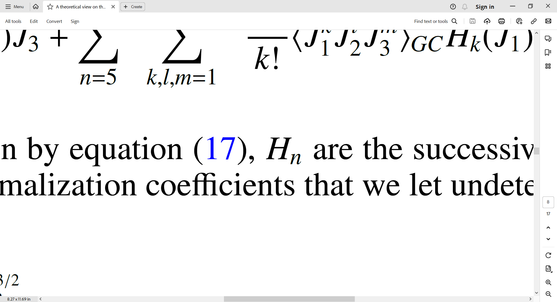
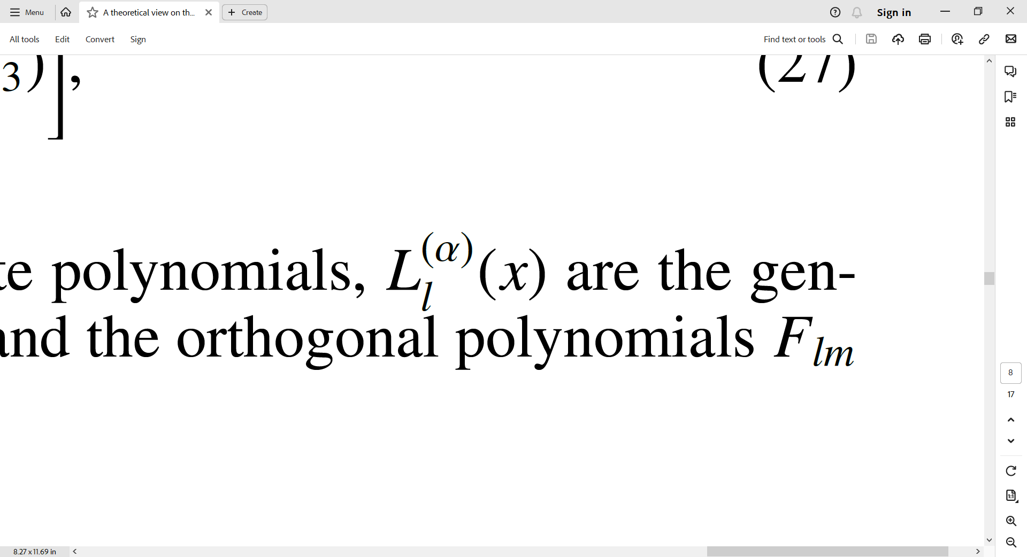
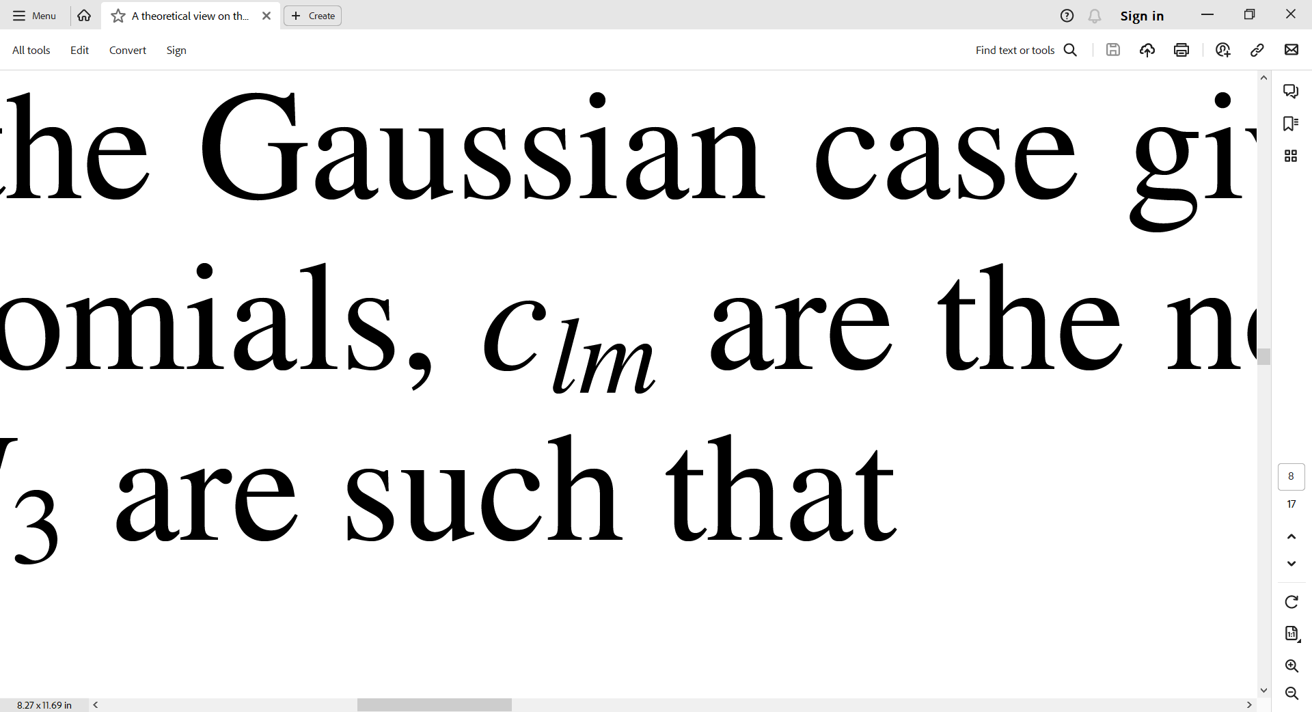
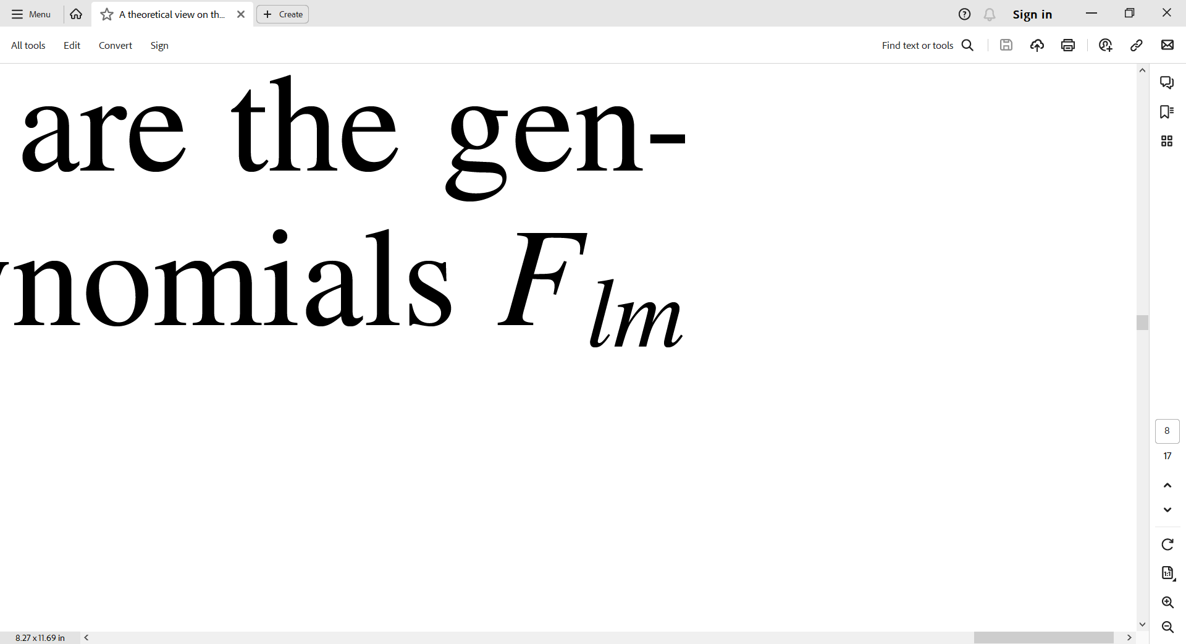
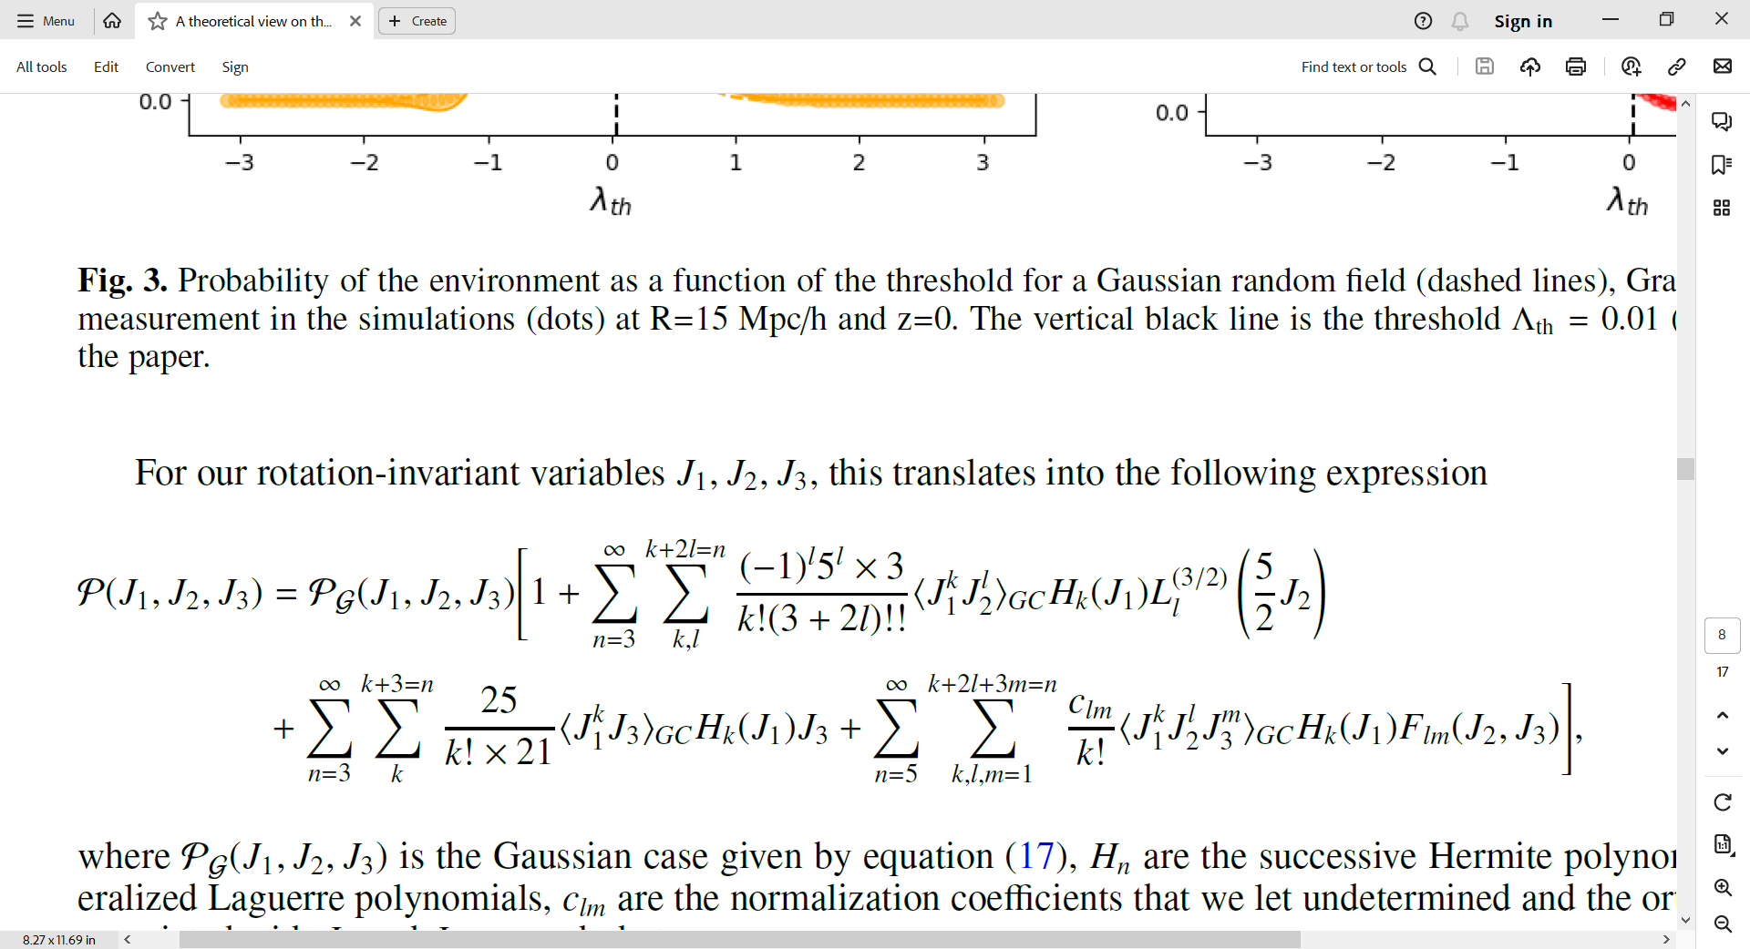
Evolution regimes:
13
77%
Non-Linear regime:
Rotation invariant variables
Hermite polynomials
Laguerre polynomials
Normalization coefficient
Orthogonal polynomials
Faculty of Physics, Kharazmi University, Tehran, Iran
arXiv:2310.03548v1
Parsa Ghafour
, 3rd December 2023

Slide 15
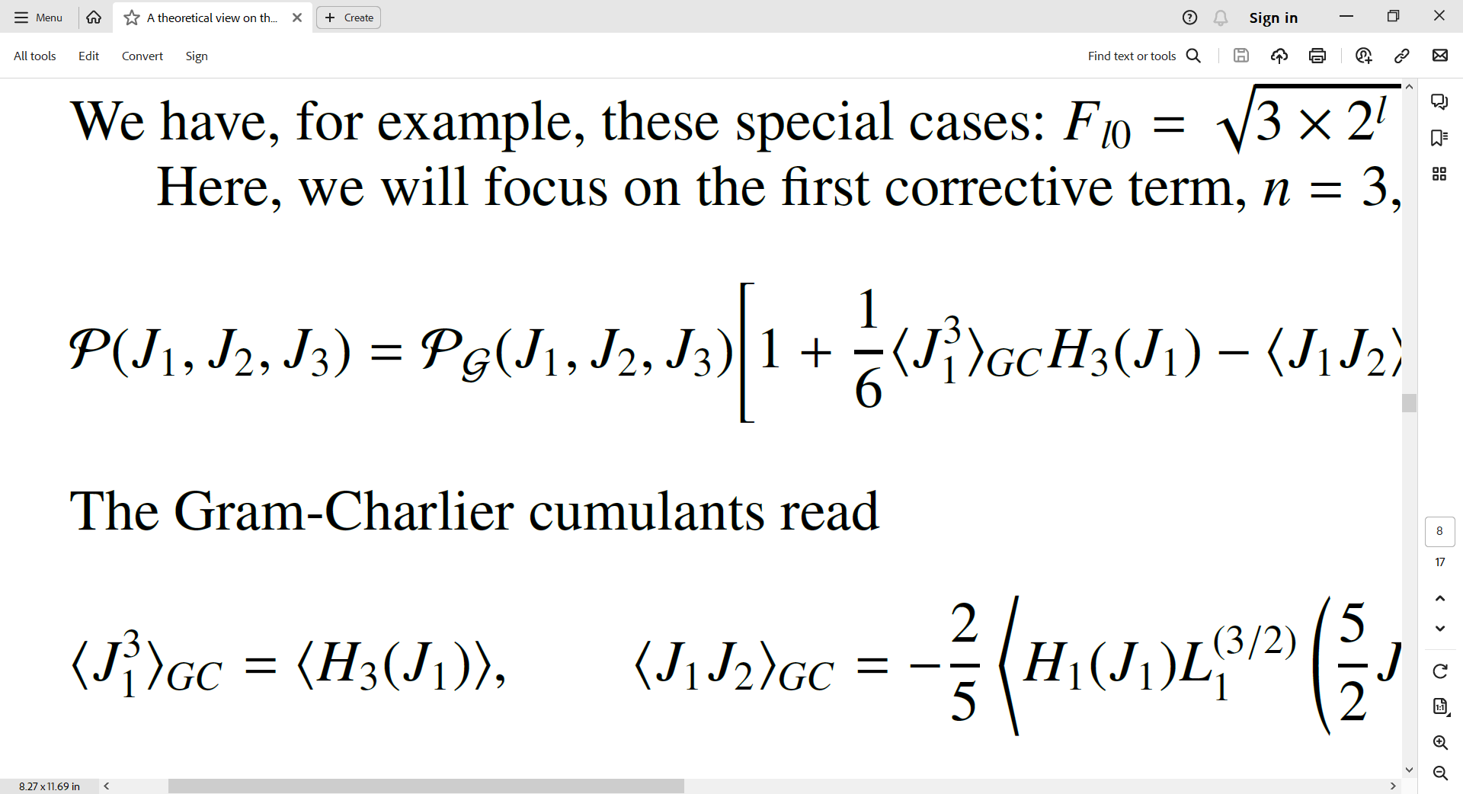
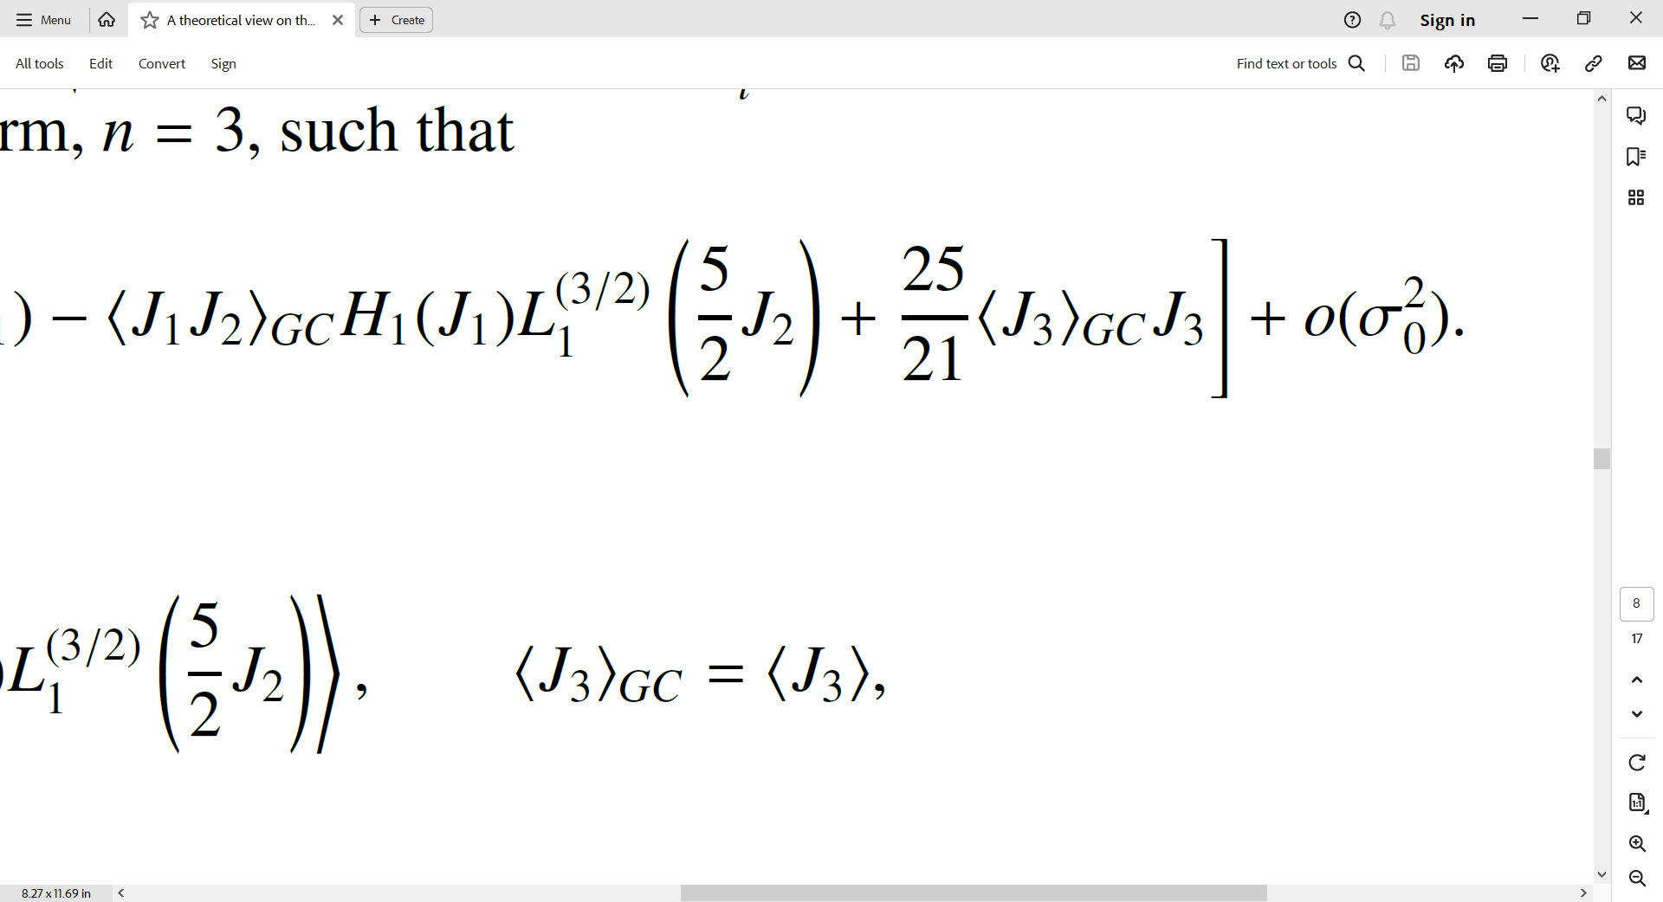



Evolution regimes:
14
83%
Non-Linear regime:
First corrective term
Gram-Charlier cumulants
Faculty of Physics, Kharazmi University, Tehran, Iran
arXiv:2310.03548v1
Parsa Ghafour
, 3rd December 2023

Slide 16



Results:
15
Gaussian prediction
Gram-Charlier prediction
Measured void
Measured wall
Measured filament
Measured knot
89%
Faculty of Physics, Kharazmi University, Tehran, Iran
arXiv:2310.03548v1
Parsa Ghafour
, 3rd December 2023

Slide 17

Results:
16
94%
Faculty of Physics, Kharazmi University, Tehran, Iran
arXiv:2310.03548v1
Parsa Ghafour
, 3rd December 2023

Slide 18

Results:
17
Voids (dark blue)
Walls (blue)
Filaments (green)
Nodes (red)
100%
Faculty of Physics, Kharazmi University, Tehran, Iran
arXiv:2310.03548v1
Parsa Ghafour
, 3rd December 2023
Notes:
Logarithm of the density contrast

